Slide 1
REFERENCING ORGANIZER

Slide 2
REFERENCING ORGANIZER
A referencing organizer is a tool or method used to systematically manage and format references or citations in academic or professional documents.
It helps ensure accuracy, consistency, and compliance with specific citation styles.
Software-Based Organizers
Manual Organizers
Online Referencing Tools
Library Management Systems

Slide 3
REFERENCING ORGANIZER
Software-Based Organizers
These are digital tools or applications designed to help users manage references, create citations, and format bibliographies.
EndNote , Zotero , Mendeley, RefWorks.
Manual Organizers
These involve using predefined systems or frameworks to manually track references.
Citation Notebooks, Spreadsheets

Slide 4
REFERENCING ORGANIZER
Online Referencing Tools
Web-based platforms designed for creating and formatting citations.
BibTeX Used with LaTeX for formatting bibliographies in scientific documents.
Easy Bib Provides citation generation in MLA, APA, and other styles.

Slide 5
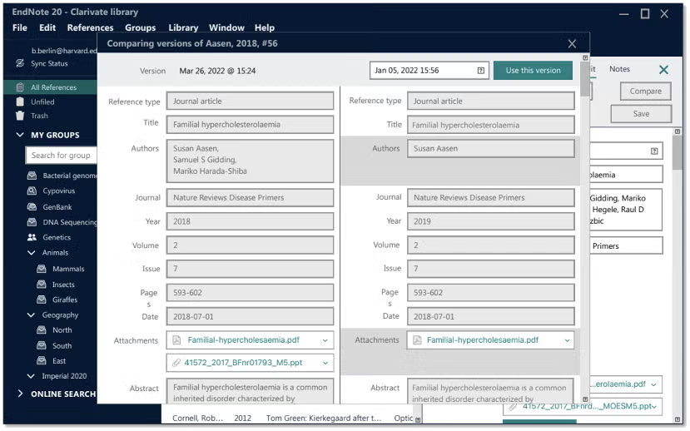
ENDNOTE

Slide 6
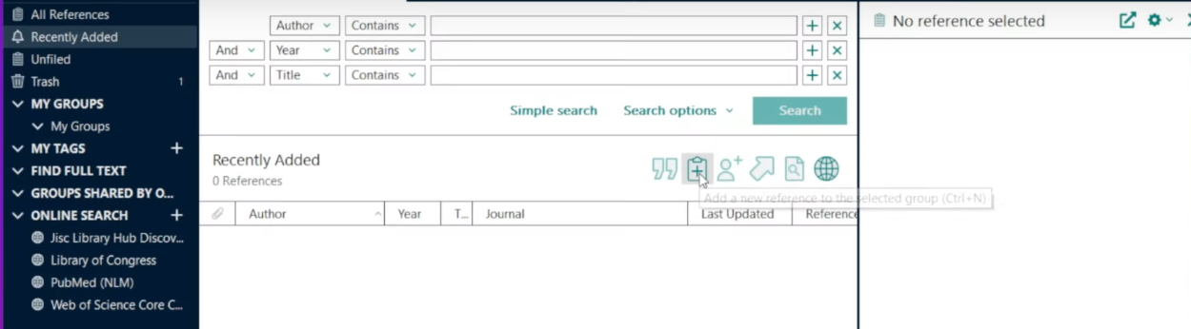
ENDNOTE

Slide 7
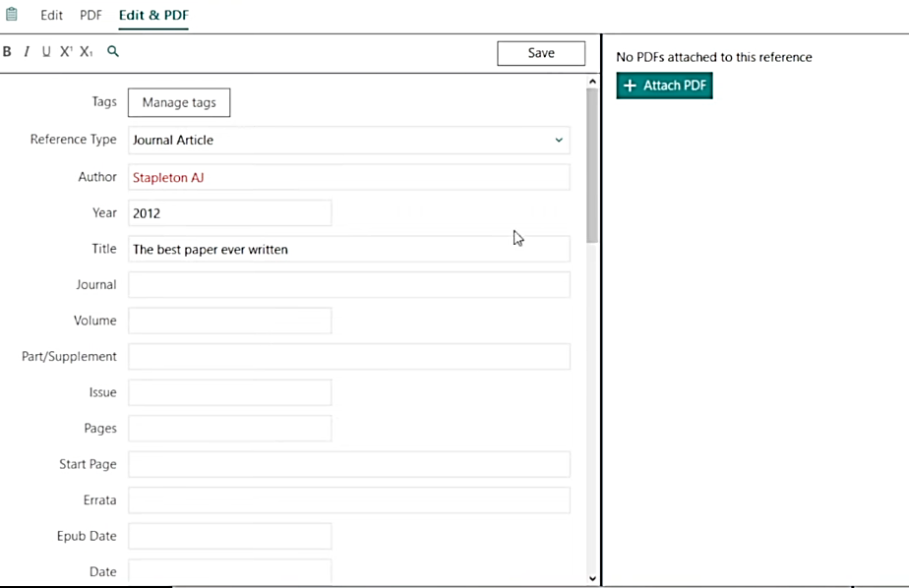
ENDNOTE

Slide 8
ENDNOTE
Creating groups of references
Create a group by going to Groups and then selecting Create Group.
A folder will appear on the left. You can name it whatever you like.
Select the references you want to add and drag them into the group you want to assign them to.
A reference can be assigned to more than one group. You can remove references from a group without deleting them from your library.
Right-click on the reference and select Remove References from Group. If you wish to delete a reference entirely, instead select Move References to Trash.

Slide 9
ENDNOTE
Adding Journal Term Lists
In EndNote, go to the Tools menu, click on Open Terms Lists, and click Journals Term List.
Click the Lists tab at the top of the window that opens.
Click the label “Import Lists”
Navigate to your Endnote Program files and open the TERMS folder
Choose the term list you want to import. Endnote will import the terms list and tell you how many terms have been added to your library. Click OK to continue.

Slide 10
ENDNOTE
Deduplicating References
Go to Library and then click Find Duplicates. You will see a side-by-side comparison of the duplicate references.
Click Keep to maintain a copy of one of the references, The other will automatically be moved to the trash. You also have the option to Skip which means both references will be kept.
If you do not want to compare each set of duplicate references, click Cancel. You will see then a list of all Duplicate References found, with the duplicate records highlighted.
To delete these duplicates, right-click (or Control-click on Mac) and select Move References to Trash.

Slide 11
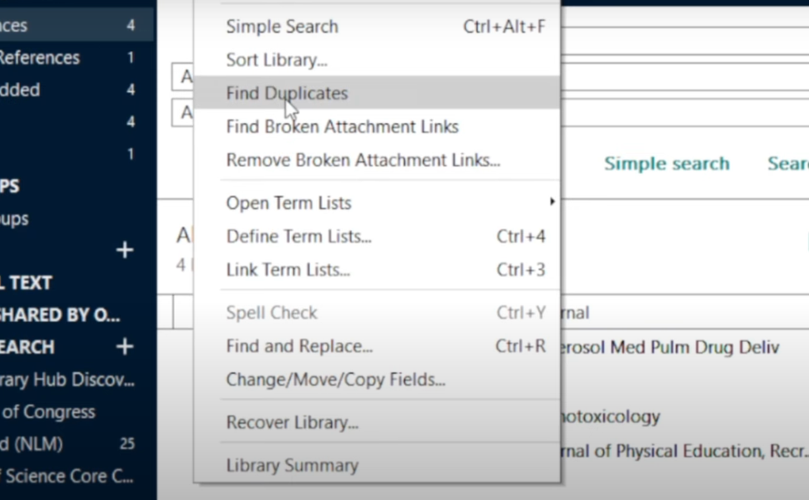
ENDNOTE

Slide 12
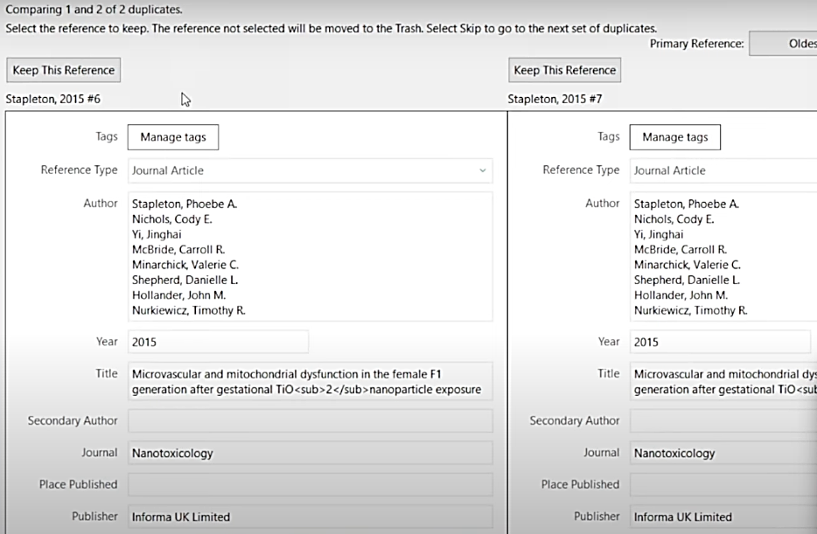
ENDNOTE

Slide 13
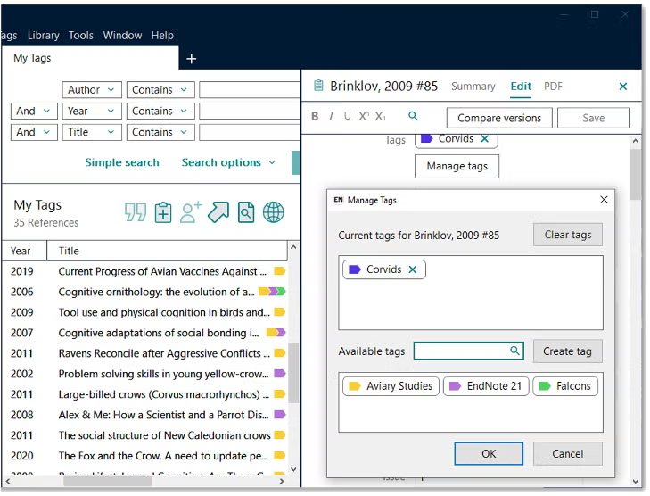
ENDNOTE

Slide 14
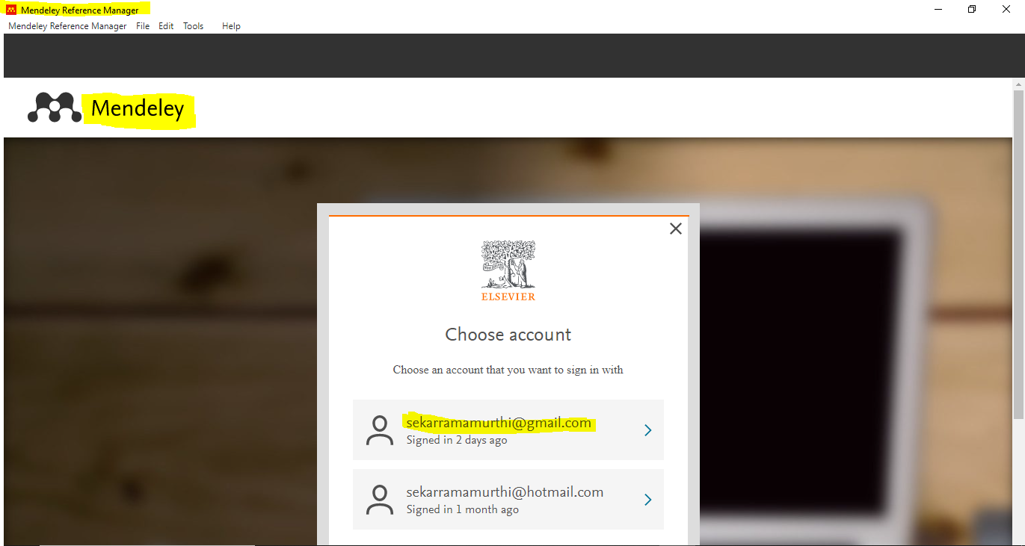
MENDELEY

Slide 15
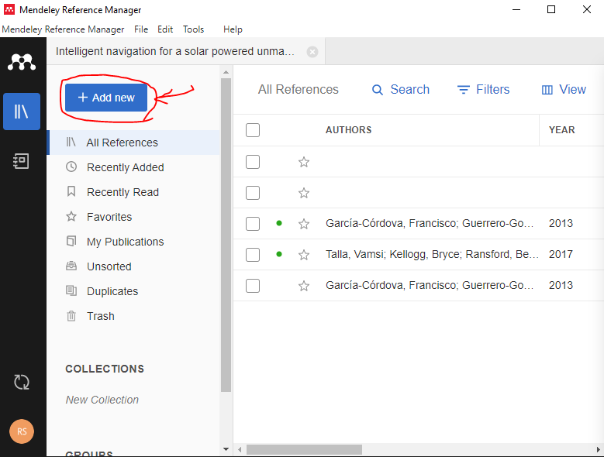

Slide 16
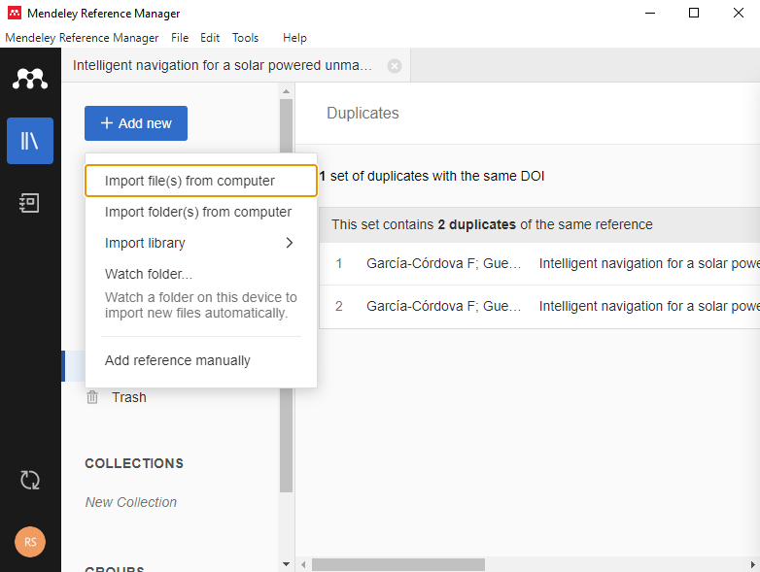

Slide 17
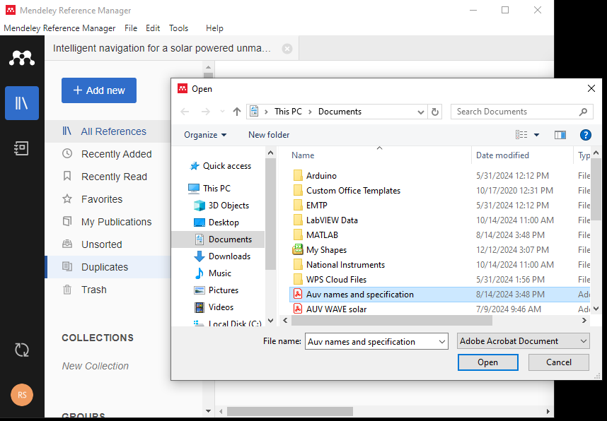

Slide 18
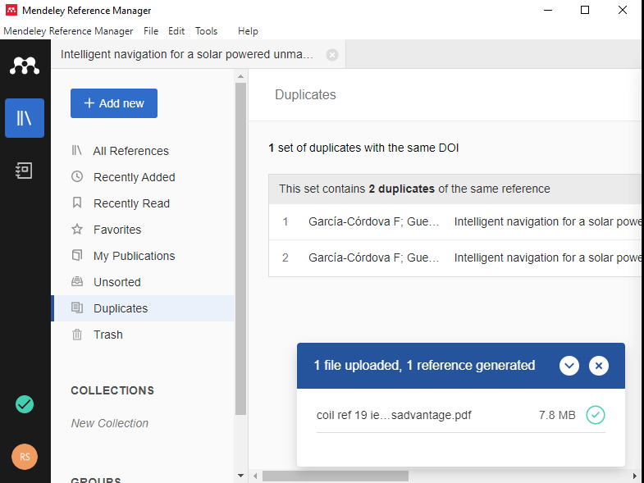

Slide 19


Slide 20
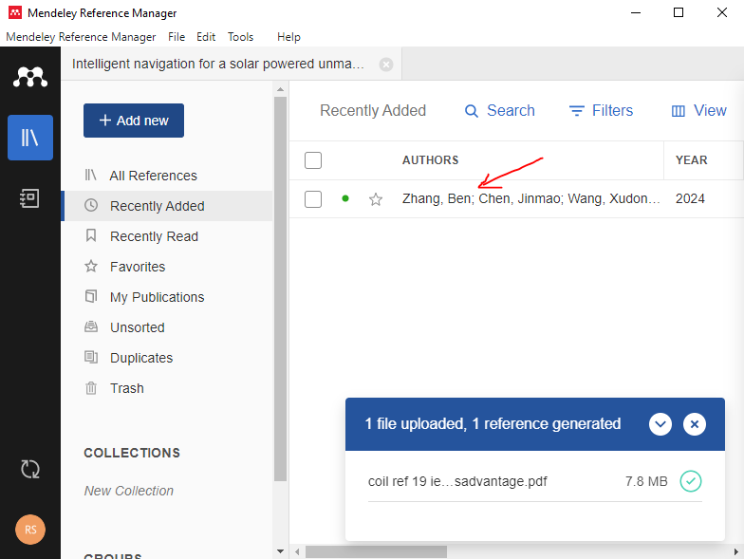

Slide 21
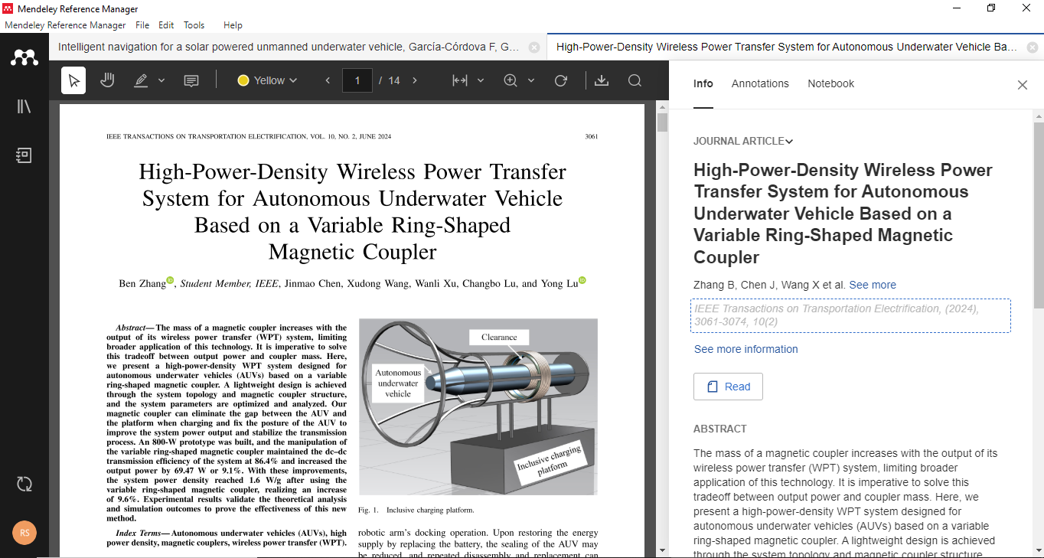

Slide 22
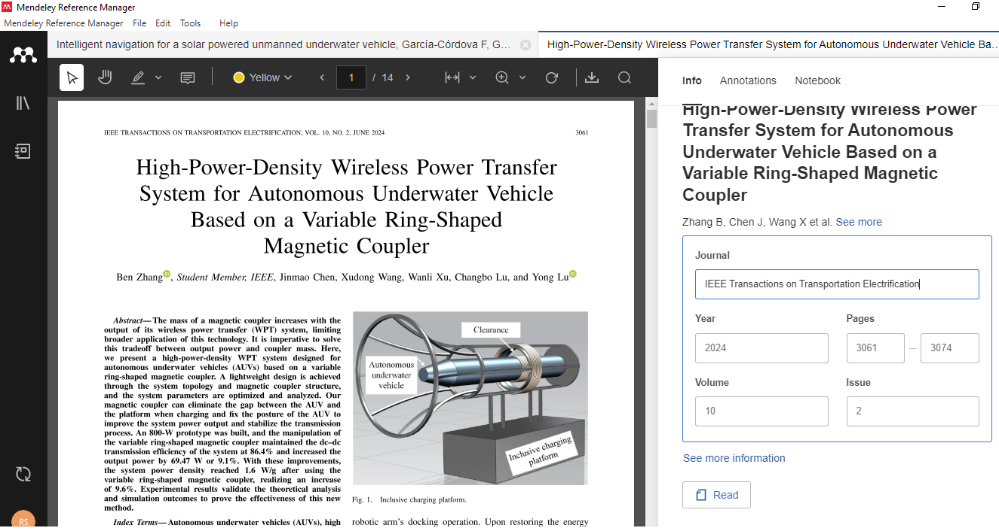

Slide 23
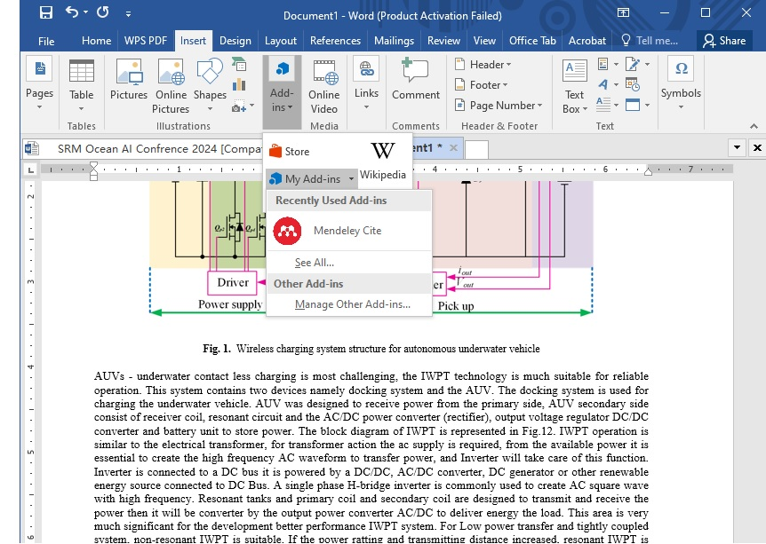

Slide 24
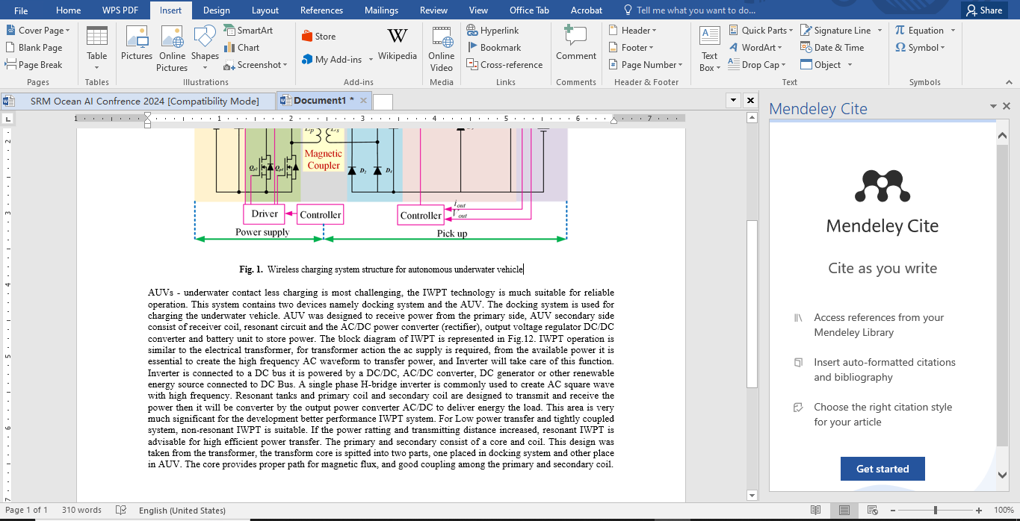

Slide 25
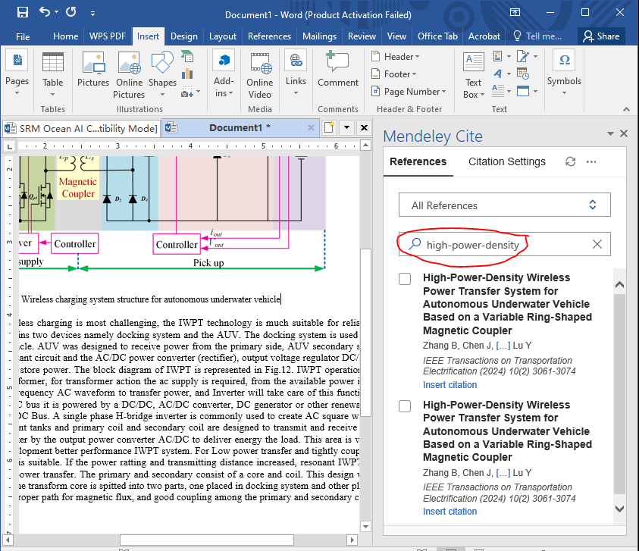

Slide 26
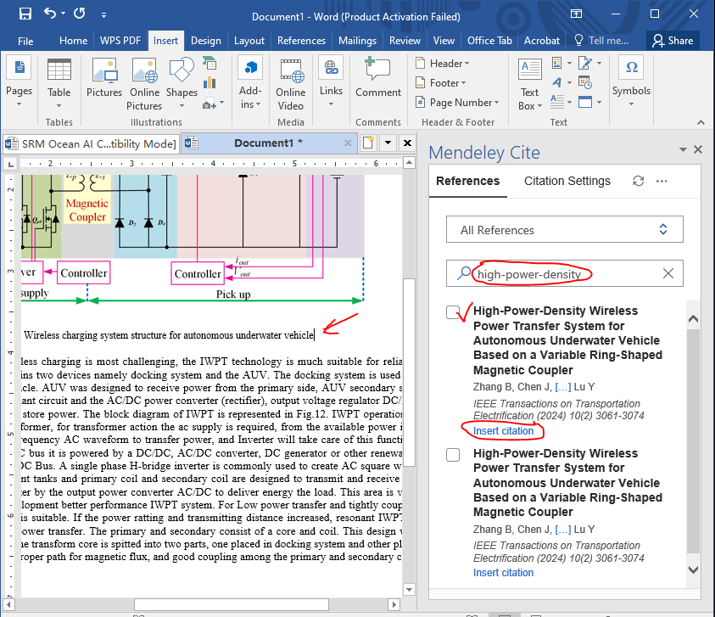

Slide 27
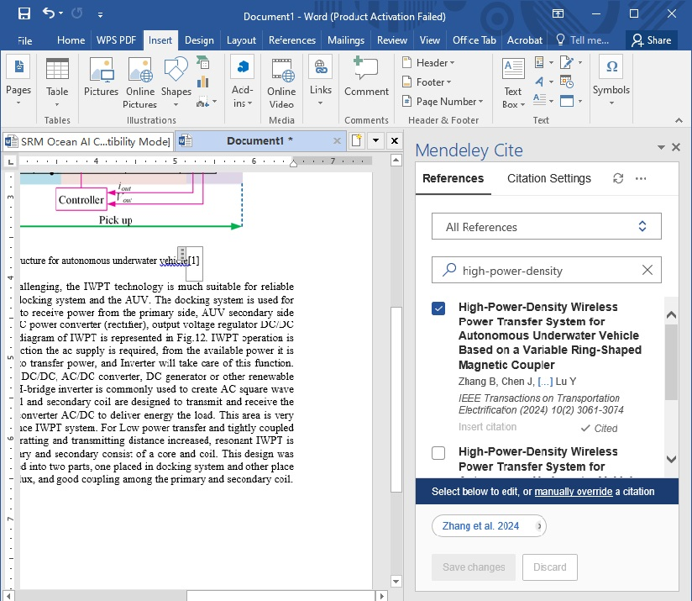

Slide 28
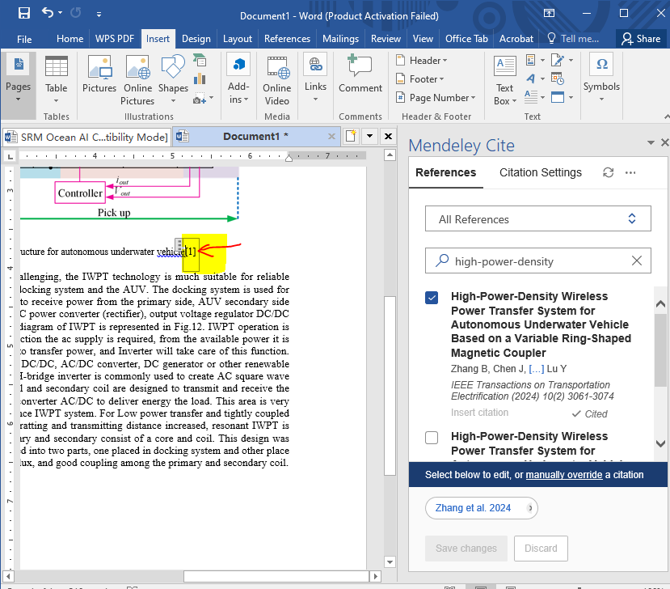

Slide 29
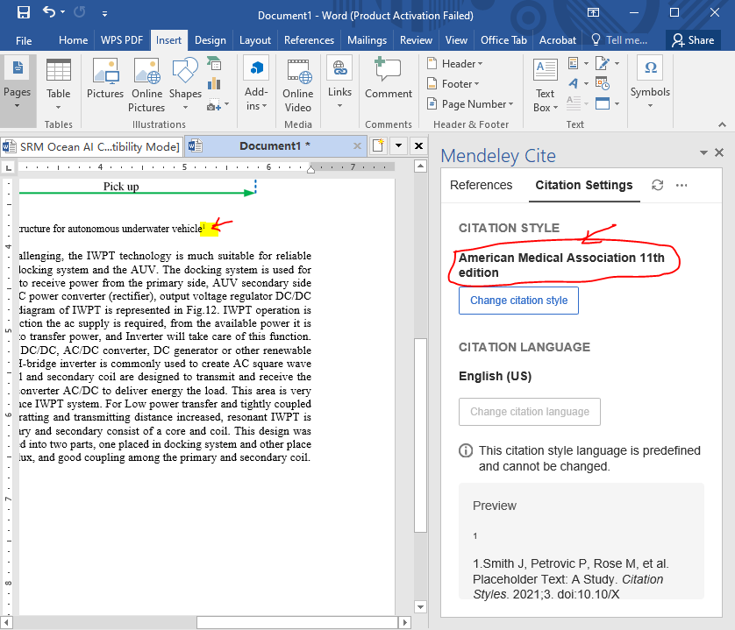

Slide 30
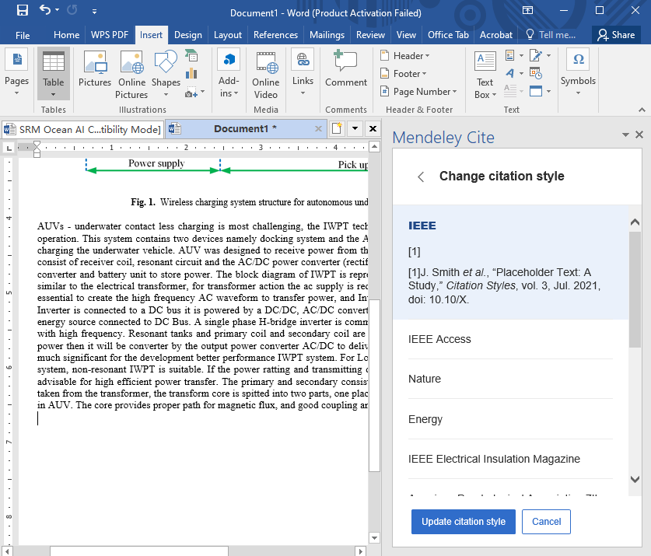

Slide 31
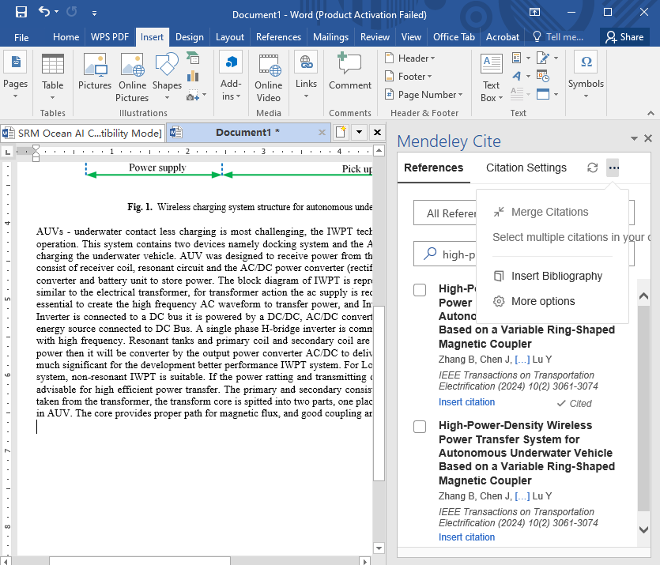

Slide 32
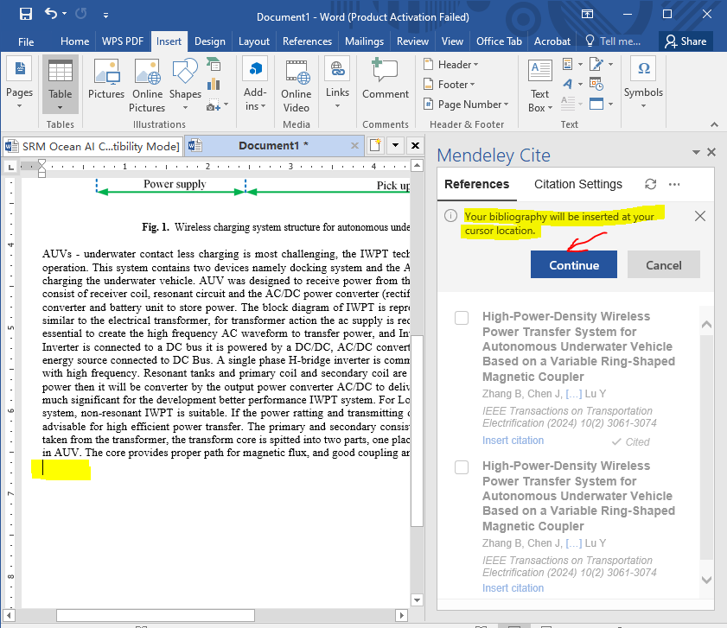

Slide 33
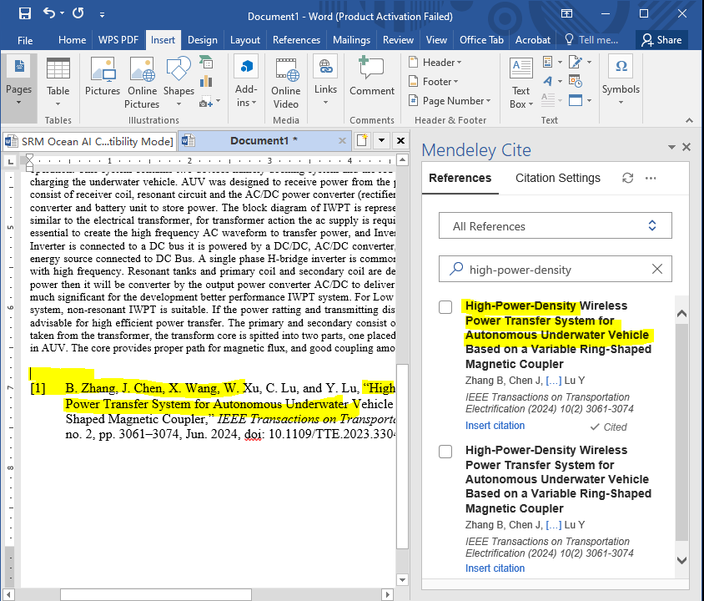

Slide 34
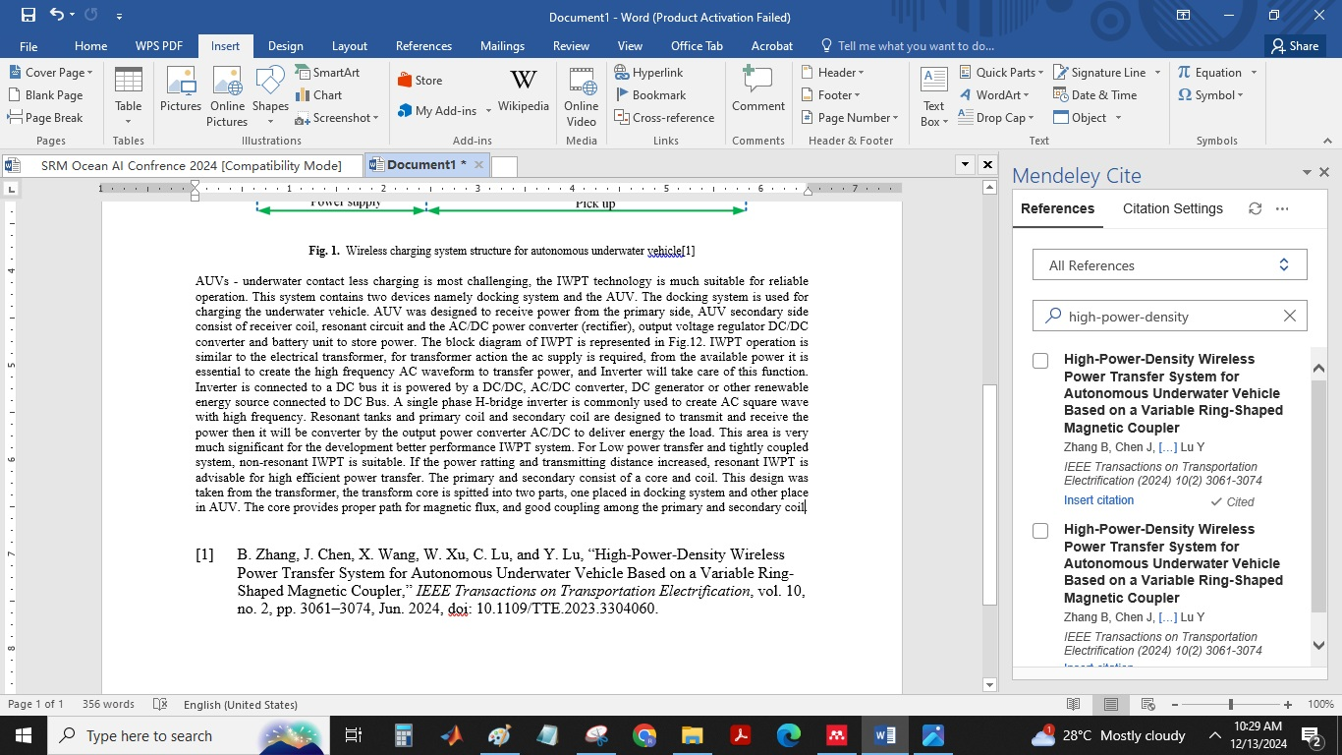

Slide 35
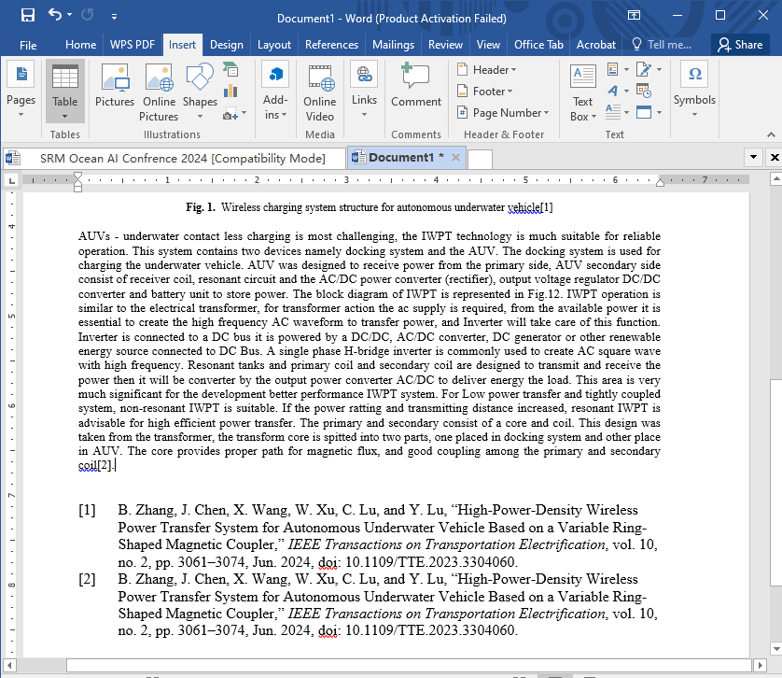

Slide 36
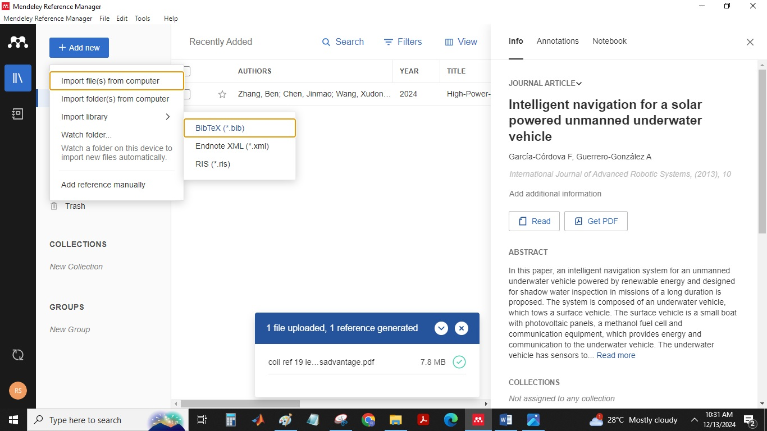

Slide 37
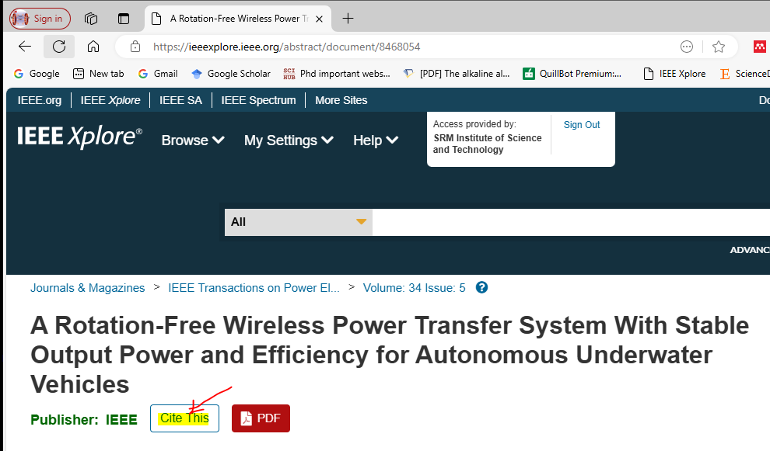

Slide 38


Slide 39
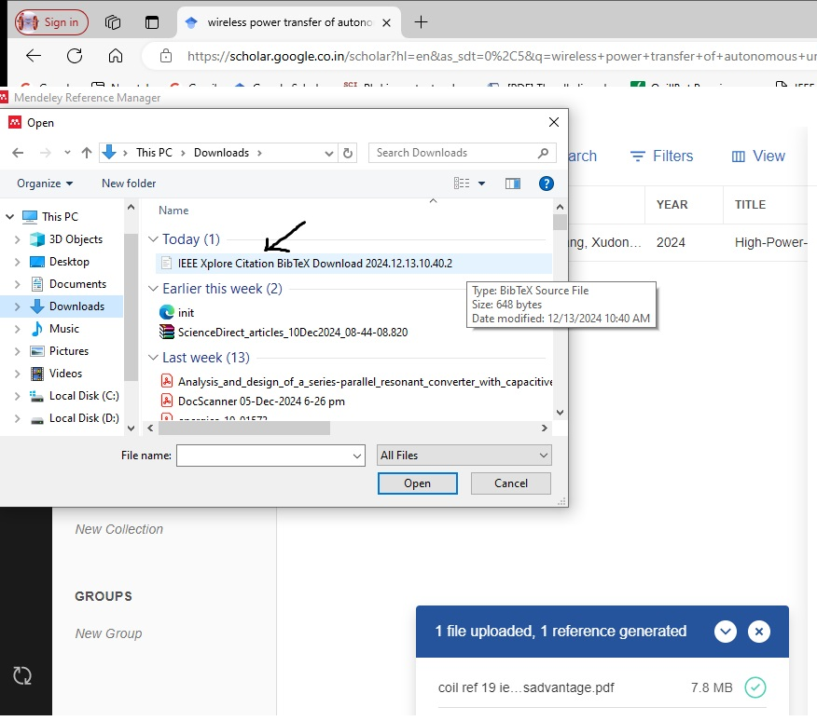

Slide 40
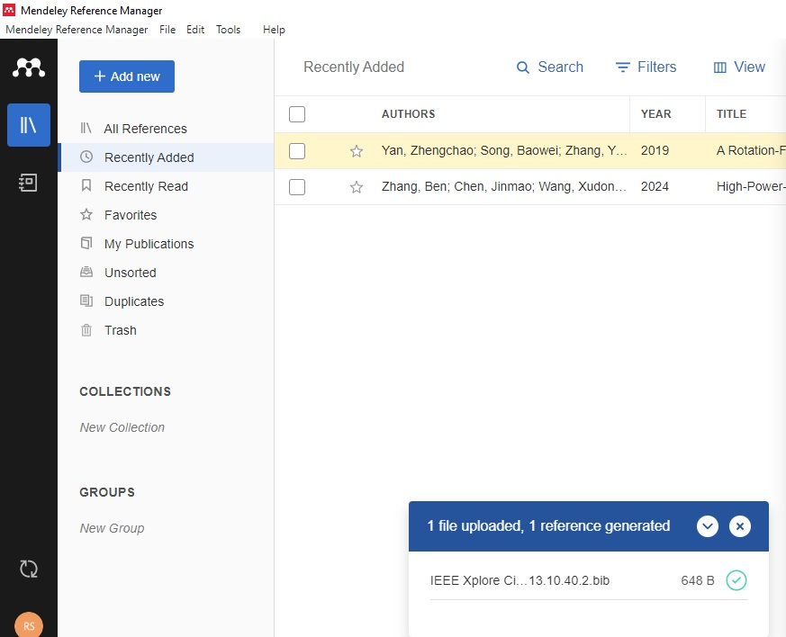

Slide 41
